Slide 1





ShopSmart
ShopSmart
App developers: Sneha Thomas, Tanya Sharma, Isha Chawan, Jingzhu Li, Ayleth Lozano

Slide 2
TABLE OF CONTENT
ShopSmart
01.
USER PROFILE
06.
PROTOTYPE
02.
NEED FOR A SHOPPING ASSISTANT
07.
MOSCOW
03.
08.
BUSINESS MODEL
WHY DOES SHOPSMART STAND OUT
04.
09.
FUTURE CHALLENGE
USE CASE DIAGRAM
05.
10.
TIMELINE FOR NEXT STEPS
DATA FLOW DIAGRAM
Page 2 | Ayleth

Slide 3




MEET MELISSA
ShopSmart
SINGLE MOTHER OF FIVE
WORKS FULL-TIME
ENVIRONMENTALLY CONSCIOUS
OVERCONSUMPTION
Page 3 | Ayleth
Notes:
MAJOR PAIN POINTS: FOOD WASTE , PAYING FOR MORE , LACK OF PRODUCT AWARENESS

Slide 4


THE NEED FOR SHOPSMART
ShopSmart
TAILORED OPTIONS
BEST PRICE GUARANTEE
INCREASED SAVINGS
Page 4 | Ayleth

Slide 5
Why ShopSmart Stands Out?
ShopSmart
Target Audience and Personalization
Real- time price comparisons
All in one solution
Nutritional Information
Exclusive Offers and Discounts
Page 5 | Isha

Slide 6
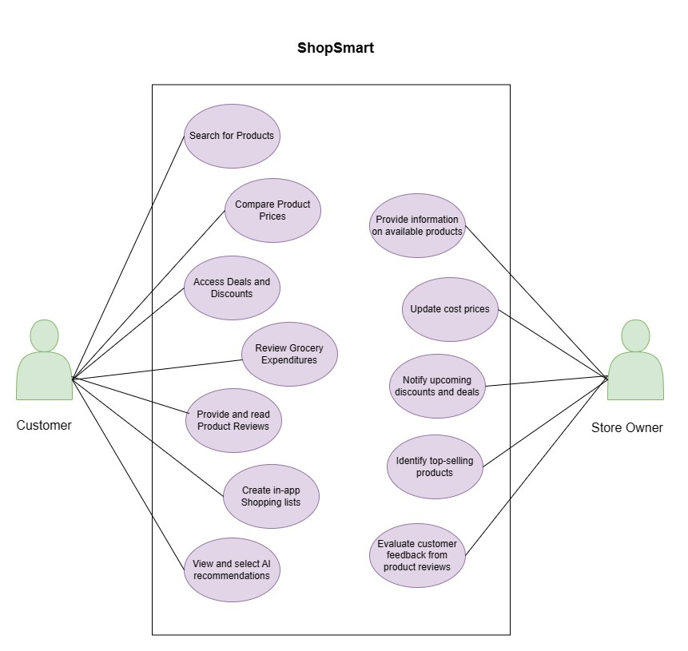
ShopSmart
USE CASE DIAGRAM
Page 6 | Isha

Slide 7
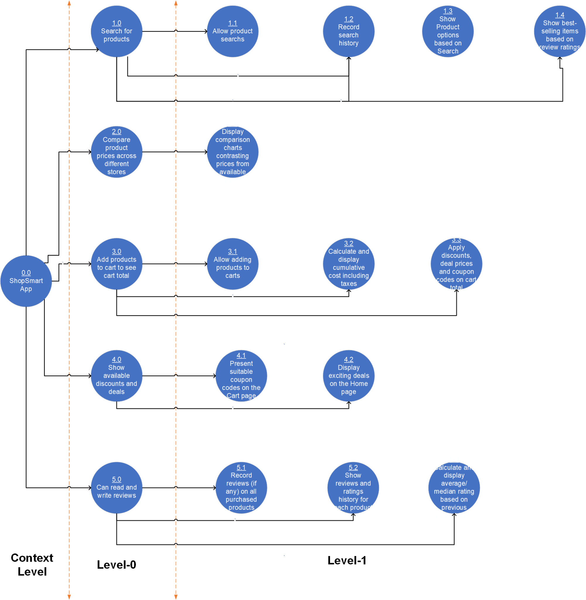
ShopSmart
DATA FLOW DIAGRAM
Page 7 | Ayleth

Slide 8
ShopSmart
SHOPSMART
PROTOTYPE
Page 9 | Tanya

Slide 9

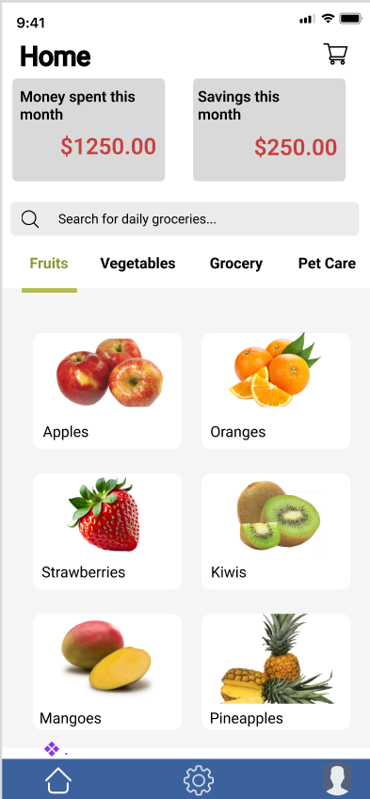

LANDING SCREEN
ShopSmart
Expenditure Dashboard
Product
Search
Product Recommendations
Navigation Bar
Page 10 | Tanya

Slide 10
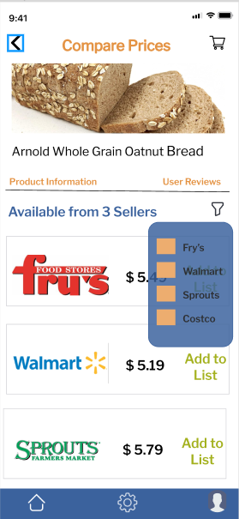
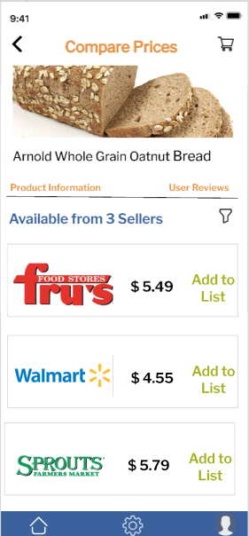
PRICE COMPARISON
ShopSmart
Shares options from multiple stores for the searched product
Add desired product
to Cart
Filter Sellers
Page 11 | Tanya

Slide 11
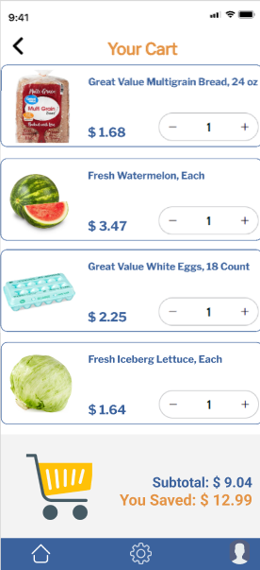
SHOPPING CART
ShopSmart
All products added
to Cart
Total spend estimates including taxes
Page 12 | Tanya

Slide 12
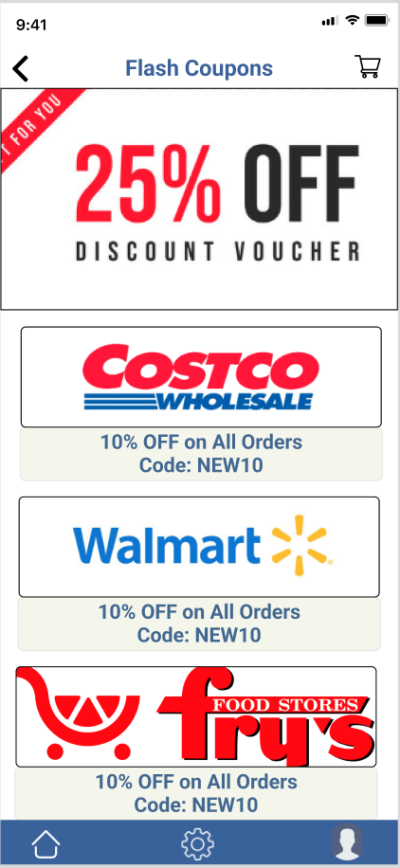
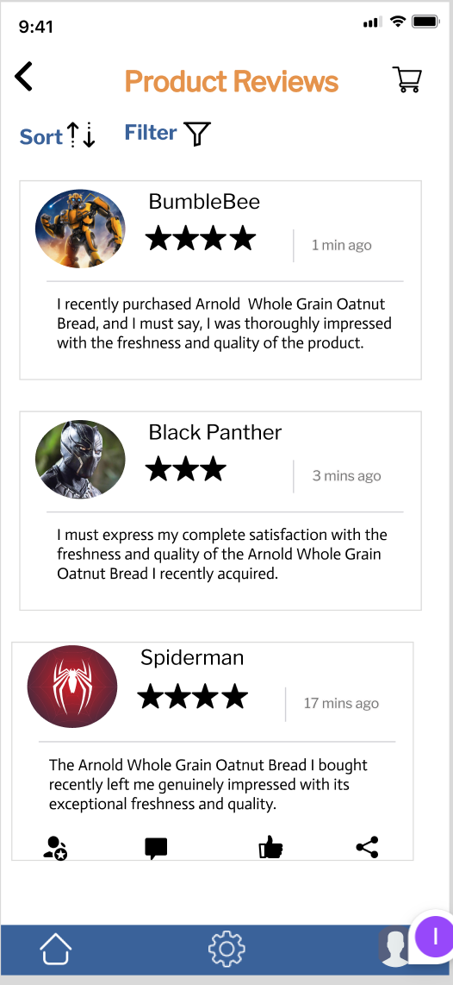
DEALS & REVIEWS
ShopSmart
Real-time reviews
Catered Discounts
Page 13 | Tanya

Slide 13
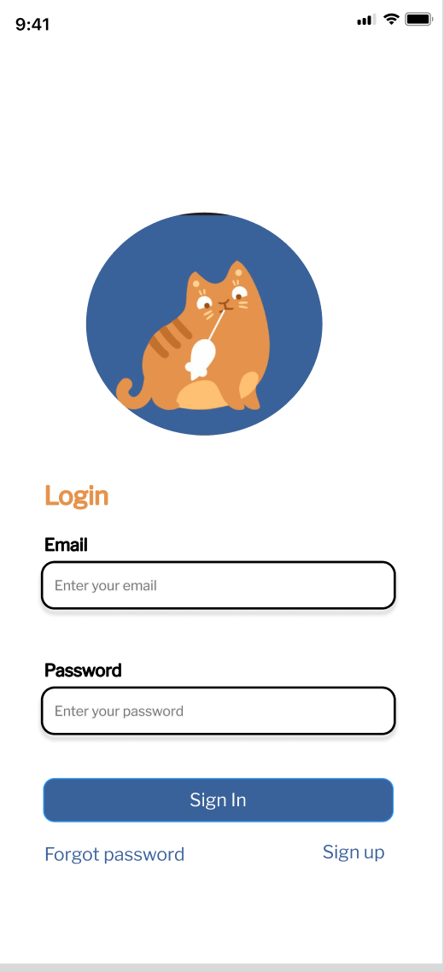
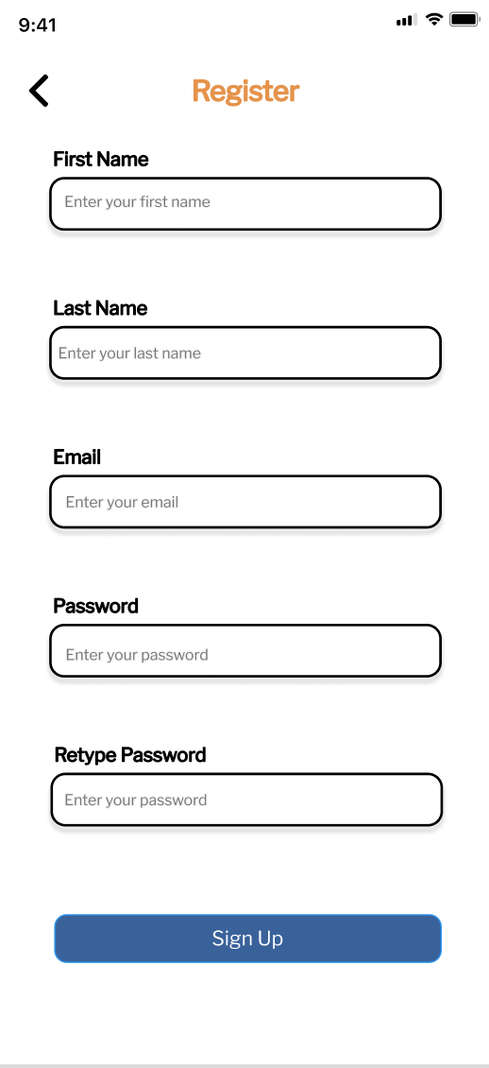
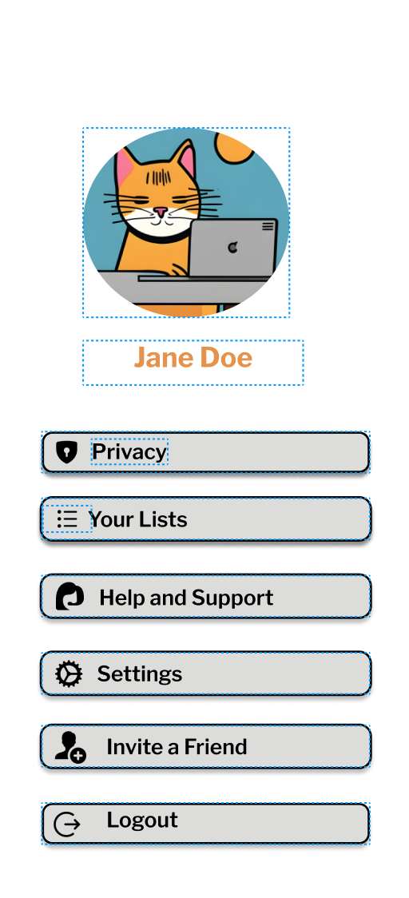
PROFILE CREATION & LOGIN SCREEN
ShopSmart
Safety Measures
Easy Login
Page 14 | Tanya

Slide 14



Feature Selection
ShopSmart
Food content, nutrition facts, calorie content
Filter undesired stores during comparison
Expiration dates
Language translation
In-built shopping lists
Compares prices across local stores
Estimated spend including taxes
Deals and Discounts
Product reviews
Monthly spend dashboards
AI product recommendations
Page 8 | Sneha

Slide 15
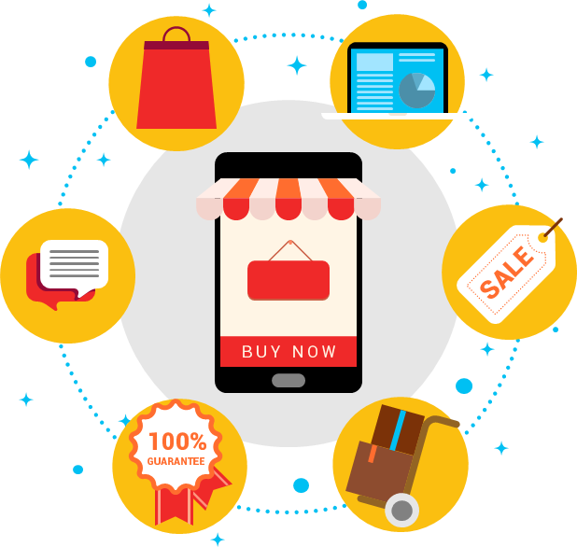
BUSINESS MODEL
ShopSmart
Premium Subscription for Business Insights
Subscription model for customers
Localised Deals & Offers
Crowdsourced Data
03 - SOCIAL MEDIA
Partnership/Commission
from Retailers &
Grocery chains
In-App advertising
Page 15 | Sneha

Slide 16
Challenge Anticipated
ShopSmart
04
Data Accuracy and Currency
Localization and Language
01
03
Algorithmic Complexity for AI
02
User Data Privacy and Security
Page 16| Jingzhu

Slide 17
FUTURE TIMELINE
ShopSmart
Enhance User Experience
Optimization and User Feedback
Prepare for Future Challenges
Core Features
Implementation
Expand Functionalities
Page 17| Jingzhu

Slide 18
THANK YOU
Shopping made Smart and Simple
ShopSmart

